Slide 1
CS 97 Discussion 1B
Week 0

Slide 2
About Myself
Name: Howard Xie
Second year Masters student in CS
UC Berkeley for undergrad
Hobbies: golf, automotive detailing, pc gaming

Slide 3
Logistics
Discussion Format
First half led by TA, second half led by LA
No LAs this week
Go over lecture topics
Focus on lab assignments
Some hints on the homework
Office Hours: Tuesdays 1-2pm and Thursdays 2-3pm (tentatively)
Assignment 1 Due Monday, 10/12 11:55pm PST

Slide 4
Today’s Agenda
Linux basics
Emacs
Go over parts of the lab assignment
Intro to Shell scripting

Slide 5
SSH
Log onto UCLA VPN (how-to here)
Log onto a SEASnet Linux server using ssh
Secure SHell: a protocol to securely transfer data across networks
ssh username@lnxsrv06.seas.ucla.edu
Replace username with your seasnet username
According to the assignment spec, you may use lnxsrv06, 07, 09, or 10

Slide 6
Basic Terminal Commands
pwd: print working directory
Tells us “where” we are currently.
cd: change directory
Lets us go somewhere else
ls: list contents of a directory
Shows us what is in a directory
man: display manual page for a given command
Instruction manual for commands
mkdir: make a new directory
Make folders
rm: remove files or directories
Delete stuff

Slide 7
Basic Terminal Commands - Directories
. : Current directory
.. : Parent directory
~ : Home directory
/ : Root directory

Slide 8
Environment Variables
These are dynamic-named values that are made available to all processes running in the current environment.
Use the “export” command to make an environment variable.

Slide 9
Environment Variables - PATH
The only environment variable we care about now is PATH
PATH holds a list of directories that tells the shell where to look for programs
pwd, cd, ls, etc are technically all programs that exist somewhere on our computers
Location of programs specified by PATH
Try echo $PATH
To prepend a directory, do export PATH=[new directory]:$PATH
Ex: export PATH=/usr/local/cs/bin:$PATH
Note: you must do this every time you log into the seasnet server unless you add that line to ~/.profile

Slide 10
Emacs
Emacs is a command line text editor
Open emacs by typing emacs in your terminal window
Here is a useful emacs cheatsheet

Slide 11
Getting Started on Lab 1
Download the assignment spec by typing
wget https://web.cs.ucla.edu/classes/fall20/cs97-1/assign/assign1.html
Rename the file assign1.html to exer1.html by typing
mv assign1.html exer1.html
Make 3 copies of the file by typing
cp exer1.html exer2.html
cp exer1.html exer3.html

Slide 12
Lab 1.1 Moving around in Emacs
How do you move the cursor without using the arrow keys?
Left: C-b (back)
Right: C-f (forward)
Up: C-p (previous line)
Down: C-n (next line)
End: C-e
Beginning: C-a

Slide 13
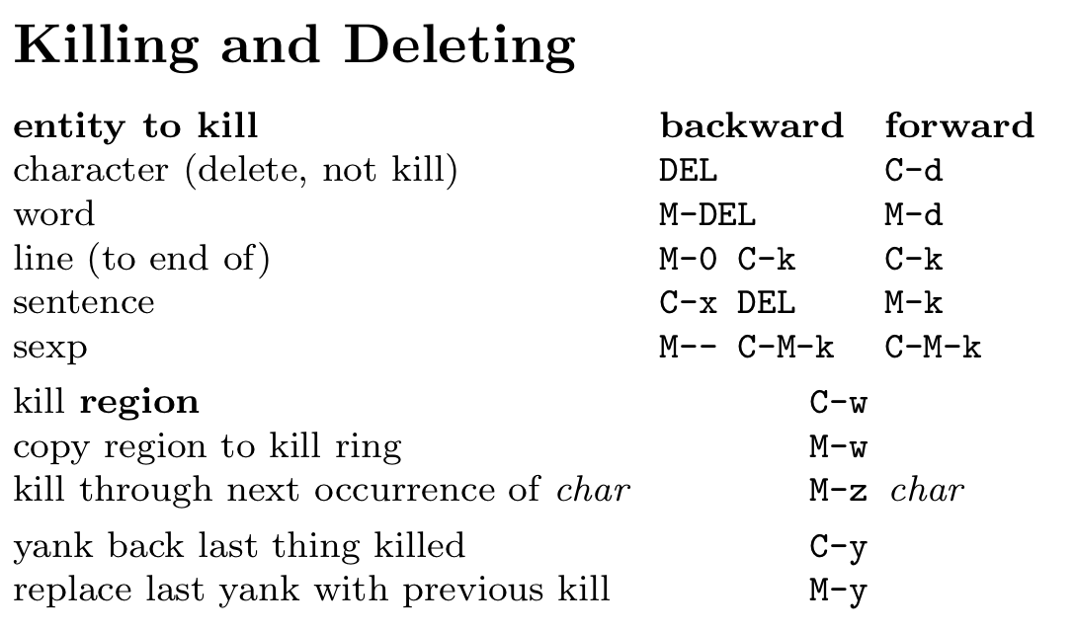
Lab 1.2: Deleting text in Emacs

Slide 14
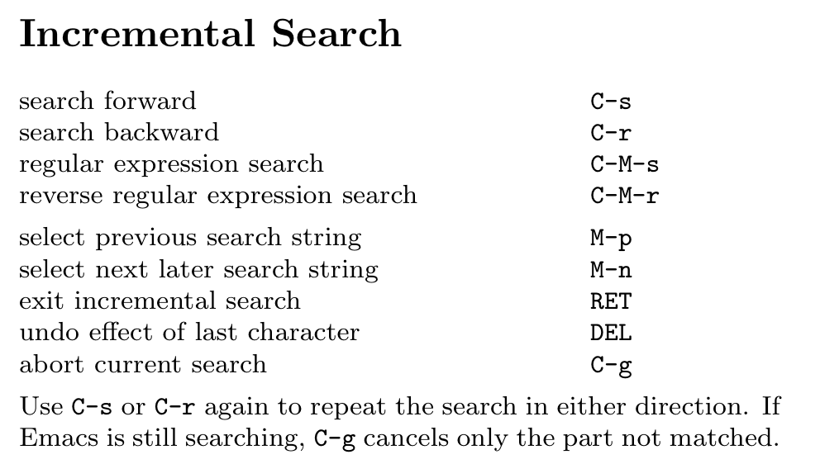
Lab 1.3: Inserting text in Emacs
Helpful to know about the search feature.

Slide 15
Input/Output Redirection
< redirects input
sort < input.txt
> redirects output
sort < input.txt > output.txt
>> appends to output file

Slide 16
Shell Scripting
What is a “shell”?
A user interface that allows access to an operating system’s services
Common Unix shells (for Unix-like OSes):
Bash, zsh, sh, csh
Bash is my favorite.

